Slide 1
Capstone Project | Explore Segmenting and cluster the neighborhood of | Delhi | India
IBM Applied Data Science Capstone Project
By : Gautam Sharma
July 2021

Slide 2
Introduction :
For Many Shoppers, Visitings Shopping Malls is a great way to relex and enjoy themselves during wekkend and holidays. They can do grocery Shopping , dine at reaturents , ahop at the various fashion outlets , wathch movie and perform many more activities .
Shopping Mallls are like one - stop destination for all types of shoppers. for retails , the central location and the large crowd at the shopping malss provides a great distribution channels to marlet their products and service.
Proverty developers are also taking advatages of this trend to build more shopping malss to cater to the demand. Opening Shopping mall serious Consideration and is a lot more complicates than it seems. Particularly, the location of the shopping mall is none of the most important decisions that will determine the mall will be success. As the many shopping malls present in Delhi , India. so developer think whuch is best place for built the Shopping Mall.

Slide 3
Business Proble:
The objective of this projecct is to analyse and select the best locations in the city of Delhi , India to opening a new Shopping Mall. Using data science and Machine Learning techniques likes Clustering .
this project aims to provoide solution to answer the business Questions . Which is the best location in delhi to built the shopping Mall?

Slide 4
Data :
To solve the problem, we will need the following data
List of neighborhood in Delhi. This defines the scope of this project whch confined to the the city of Delhi.
Latitude and Longitude coordinates of those neighborhoods . This required in order to plot the map and also to get the venue data.
Venue data , particularly data related to shopping malls. we will use tis data toperform clustering on the neighborhood

Slide 5
Methodlology:
Web scraping Wikipedia page for neighborhoods list
Get latitude nad longitude coordiantes using Geocoder
Use Foursquare API to get venue data
Group data by neighborhood and takingbthe mean of frequency of occurance of each venue category
Filter venue category bu shopping mall
Perform clusterinfg on the data by using k-means clustering
Visulaize the clustering in a map using folium

Slide 6
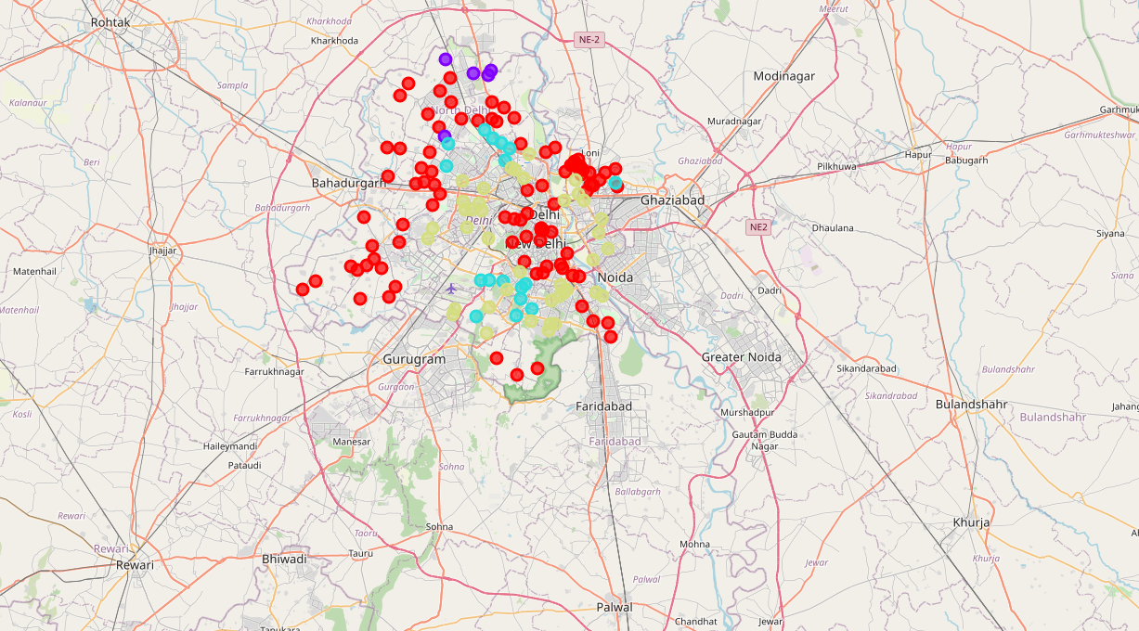
Results :
The results from the k-means clustering show that we can categorized into 4 clusters on the freuency of occurance of Shopping Mall
Cluster 0: Neighborhood with moderate number of number of shopping mall
cluster 1: Neighborhood with Low number of number of shopping mall
cluster 2: Neighborhood with Large number of number of shopping mall
cluster 3: Neighborhood with Large number of number of shopping mall

Slide 7
Conclusion :
Answer to business question : The neighborhoods in cluster 2 are the most preferred locations to open a new shopping mall.
Findings of this project will help the relevant stakeholders to capitalize on the opportunities on
High locations while avoiding overcrowded area s in their decisions to open a new shopping mall.

Slide 8
Thank You !

